Slide 1


.
Project Title :
.

Slide 2

AGENDA
Team Members
Vaishnavi Bokare(21uad006)
Tejas Chavan (21uad007)
Digvijay Desai (21uad009)
Jyoti Dhekale (21uad010)

Slide 3
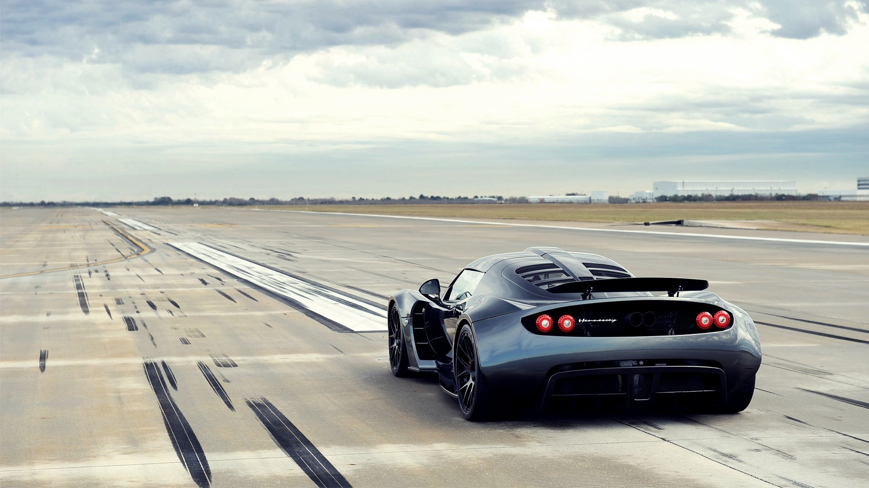
.
Introduction
‘AutoRate’ aims to address the lack of transparency in the price of used cars .
Our goal is to empower the customers with the knowledge of factors influencing vehicle price.

Slide 4
.
PROBLEM STATEMENT
“Developing a machine learning-based system to accurately predict the selling price of old cars.”

Slide 5
.
PROBLEM DESCRIPTION
In the world of selling old cars, it's often tough to know how much to ask for.
Traditional methods can be unreliable, leading to unfair prices for sellers and uncertainty for buyers.
Our project aims to fix this by using smart technology to predict accurate selling prices based on factors like age, mileage, brand, and condition.
By creating a reliable pricing system, we hope to make selling and buying old cars easier, fairer, and more transparent for everyone involved.

Slide 6
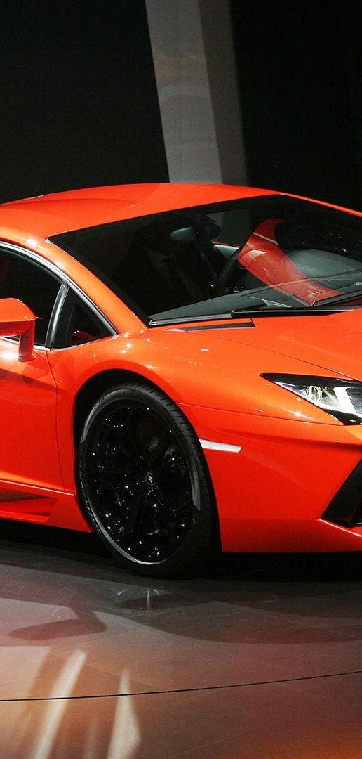
Ground-level research
Step 1 : Field Research .
Step 2 : Observation of pricing methodologies.
Step 3 : Data analysis on vehicles characteristics.
Step 4 : Collaboration and evaluation with team .
Step 5 : Selection of key components for AutoRate model.

Slide 7
REQUIREMENT SPECIFICATION
Input data sourced from structured datasets or user-provided information.
Data fields include brand, model, year, mileage, fuel, engine, seats etc.
Prediction output delivered in a user-friendly format, possibly through a web interface or mobile app.
Accuracy and reliability crucial; model evaluation metrics established for validation.

Slide 8
input
1. Brand Name 6. Transmission
2. Passing Year 7. Owner
3. Mileage: 8. Seats
4. Kilometer Driven 9. Fuel Type
5. Engine 10. Seller Type
OUTPUT
Predicted old car prices based on features, market trends, and condition. Utilized machine learning models for accuracy.

Slide 9
Features of project
Price Prediction : Provides accurate estimation for price.
User-friendly : Simple interface ensures easy input and quick result .
Continuous refinement : Model evolve with new data for accurate predictions .

Slide 10
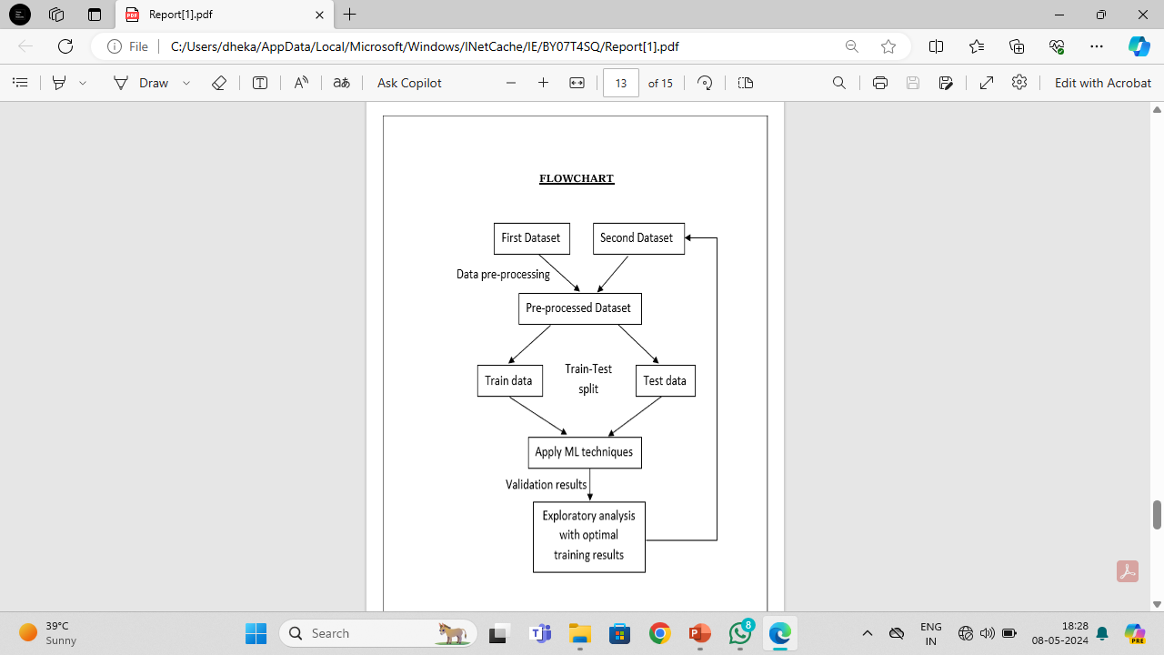

Slide 11
conclusion
In conclusion, the old car price prediction project harnesses the power of machine learning to provide accurate and reliable estimates of old car prices.
By leveraging historical sales data and various car features, the system enables users to make informed decisions when buying or selling old cars.

Slide 12
Thank you
.

